Slide 1
A Primer on
AWS Services for
Data Science
Project: Cause of Death Classification

Slide 2
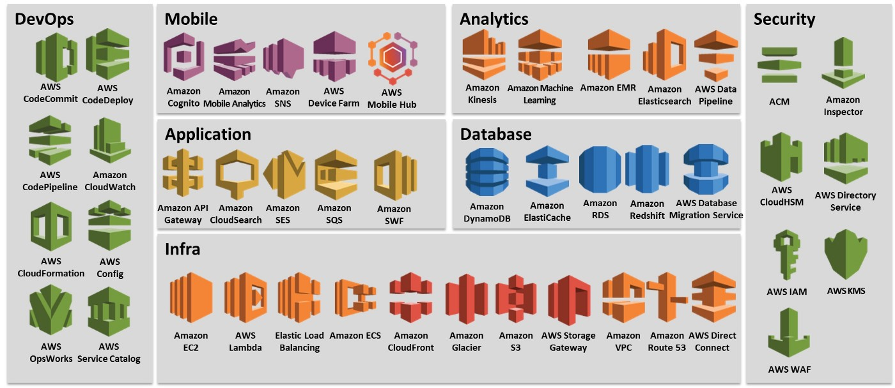
Amazon Web Service (aka AWS)
Amazon web service is an online platform that provides scalable and cost-effective cloud computing solutions. AWS is a broadly adopted cloud platform that offers several on-demand operations like compute power, database storage, content delivery, etc., to help corporates scale and grow.

Slide 3
Tech Stacks Used:
AWS Redshift
AWS S3
AWS Sagemaker
AWS Lambda
AWS API Gateway

Slide 4
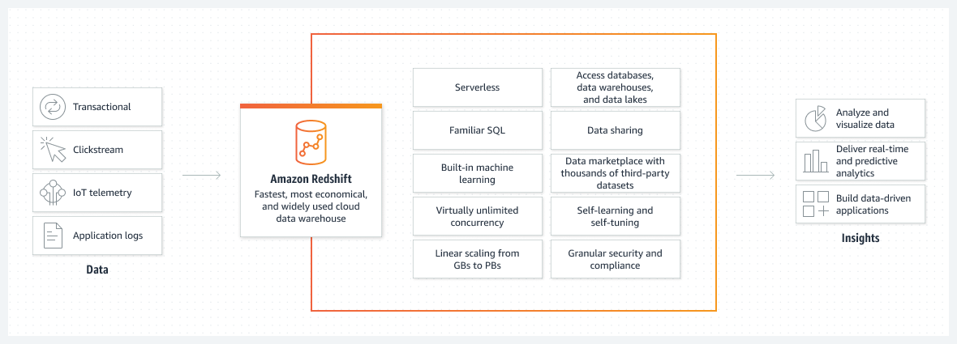
AWS Redshift
Amazon Redshift is a fully managed, petabyte-scale data warehouse service in the cloud. You can start with just a few hundred gigabytes of data and scale to a petabyte or more. This enables you to use your data to acquire new insights for your business and customers.

Slide 5
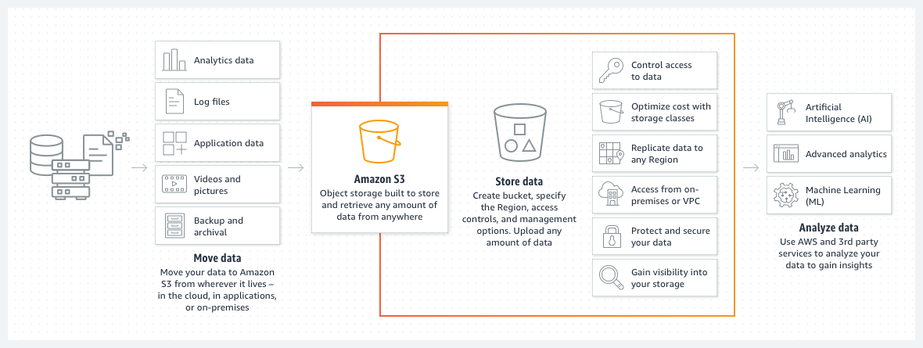
AWS S3
Amazon Simple Storage Service (Amazon S3) is an object storage service that offers industry-leading scalability, data availability, security, and performance. Customers of all sizes and industries can use Amazon S3 to store and protect any amount of data for a range of use cases, such as data lakes, websites, mobile applications, backup and restore, archive, enterprise applications, IoT devices, and big data analytics. Amazon S3 provides management features so that you can optimize, organize, and configure access to your data to meet your specific business, organizational, and compliance requirements.

Slide 6
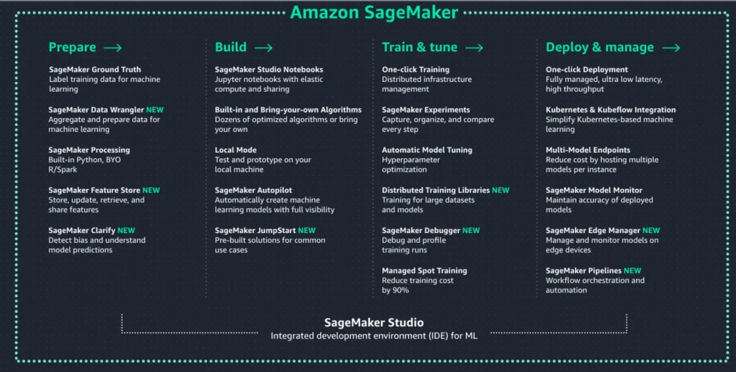
AWS Sagemaker
Amazon SageMaker is a fully managed machine learning service. With SageMaker, data scientists and developers can quickly and easily build and train machine learning models, and then directly deploy them into a production-ready hosted environment. It provides an integrated Jupyter authoring notebook instance for easy access to your data sources for exploration and analysis, so you don't have to manage servers. It also provides common machine learning algorithms that are optimized to run efficiently against extremely large data in a distributed environment. With native support for bring-your-own-algorithms and frameworks, SageMaker offers flexible distributed training options that adjust to your specific workflows. Deploy a model into a secure and scalable environment by launching it with a few clicks from SageMaker Studio or the SageMaker console. Training and hosting are billed by minutes of usage, with no minimum fees and no upfront commitments.

Slide 7
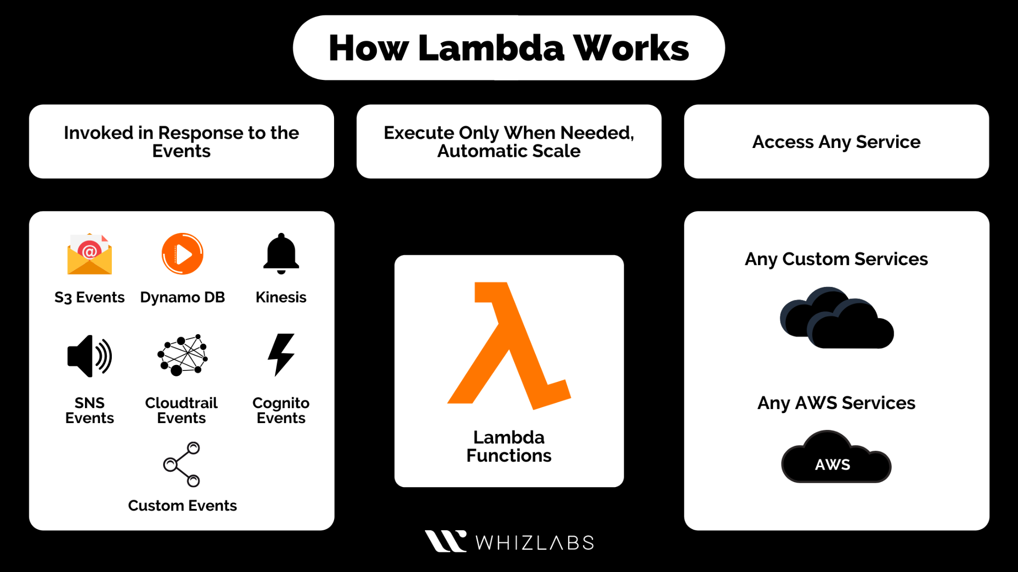
AWS Lambda
Lambda is a compute service that lets you run code without provisioning or managing servers. Lambda runs your code on a high-availability compute infrastructure and performs all of the administration of the compute resources, including server and operating system maintenance, capacity provisioning and automatic scaling, and logging. With Lambda, you can run code for virtually any type of application or backend service. All you need to do is supply your code in one of the languages that Lambda supports.

Slide 8
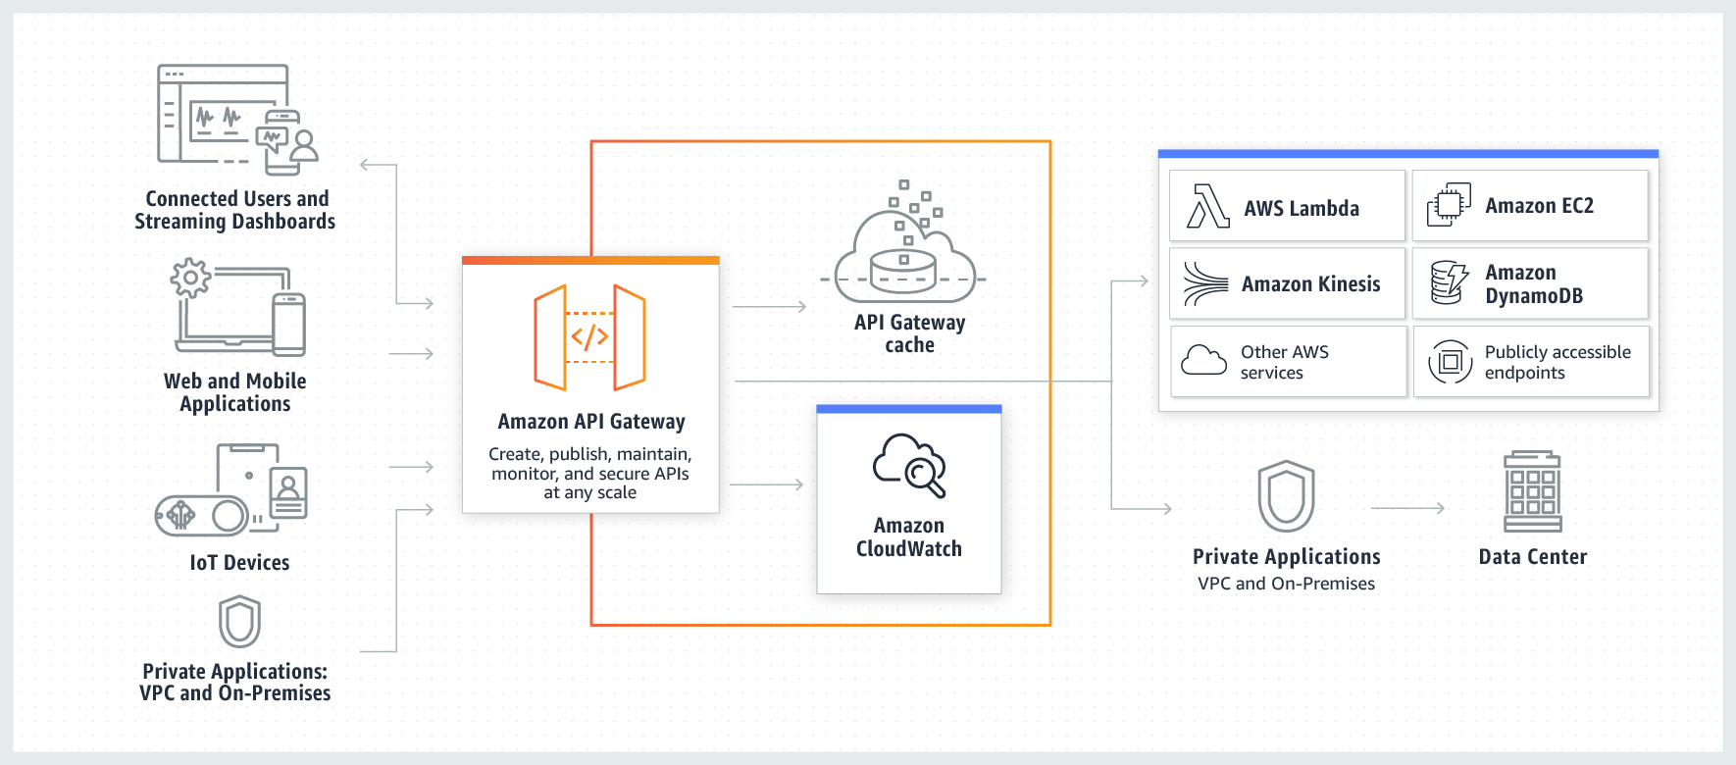
AWS API Gateway
Amazon API Gateway is a fully managed service that makes it easy for developers to create, publish, maintain, monitor, and secure APIs at any scale. APIs act as the "front door" for applications to access data, business logic, or functionality from your backend services. Using API Gateway, you can create RESTful APIs and WebSocket APIs that enable real-time two-way communication applications. API Gateway supports containerized and serverless workloads, as well as web applications.

Slide 9
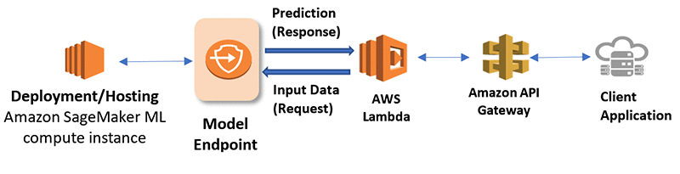
Deployment Architecture

